Slide 1
Key-insights of Papers “Peeking inside the black-box” & “Deep K-Nearest Neighbors” in light of our XAI quest
with suggestions to further research
By Joost Berkhout (29-6-2020)

Slide 2
“Peeking inside the black-box”
Paper: Peeking inside the black-box: A survey on explainable artificial intelligence (XAI) by Adadi and Berrada (2018)
Review on XAI based on 381 papers
No standard and generally accepted definition of XAI
In ML: “interpretable” more used than “explainable”
Tradeoff must be made between accuracy & interpretability
Social science are not sufficiently visible (human in the loop)
Useful XAI-methods consider:
Explanations are contrastive (why E instead of F?)
Explanations are selective (1 or 2 possible causes)
Explanations are interactions for knowledge transfer (explainer must be able to leverage the mental model of the explainee)
Notes:
Technically, there is no standard and generally accepted
denition of explainable AI. Actually, XAI term tends to refer
to the movement, initiatives, and efforts made in response to
AI transparency and trust concerns, more than to a formal
technical concept. Thus,
Rarely in literature, we come across the term ``social science''
or it derivative, yet explanation is a form of social
interaction and clearly, it has psychological, cognitive and
philosophical projections. Based on the conducted analysis,
ideas from social science and human behavior are not suf-
ciently visible in this eld.
Human feedback for the evaluation of XAI-methods.
A common factor that directly impacts the quality of
explainability and which is approached from different viewpoints
in the above studies is: Human.
He highlighted three major ndings:
(i) Explanations are contrastive: people do not ask why event
E happened, but rather why event E happened instead of some
event F. (ii) Explanations are selective and focus on one or two
possible causes and not all causes for the recommendation.
(iii) Explanations are social conversation and interaction for
transfer of knowledge, implying that the explainer must be
able to leverage the mental model of the explainee while
engaging in the explanation process. He asserted that it is
imperative to take into account these three points if the goal
is to build a useful XAI.
A call for using social science

Slide 3
“Peeking inside the black-box”
Paper: Peeking inside the black-box: A survey on explainable artificial intelligence (XAI) by Adadi and Berrada (2018)
Model-agnostic interpretability types:
Visualization (most human-centered technique)
Knowledge extraction (e.g., train linear model on net predictions)
Influence methods (pertubations, LRP)
Example-based explanation (Deep K-Nearest Neighbors)
Comparatively, little attention is given to combining different interpretability methods for more powerful explanation

Slide 4
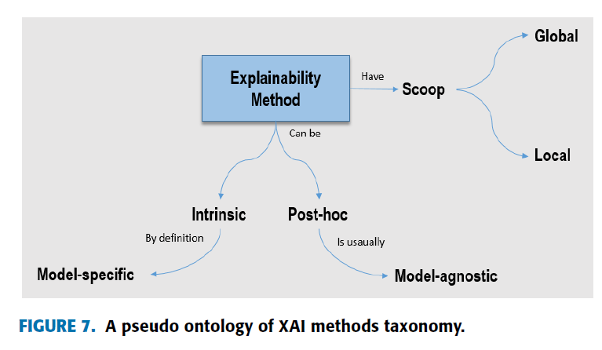
“Peeking inside the black-box”
Paper: Peeking inside the black-box: A survey on explainable artificial intelligence (XAI) by Adadi and Berrada (2018)
e.g., LRP
e.g., LRP
Notes:
To sum up (Figure 7), a key distinction is drawn in current
thinking in terms of explaining the ML based AI system
between true transparency (interpretable models such as decision
tree, rules and linear models) and post-hoc interpretations,
additional techniques used to lighten up the darkness of
complex black-box models such as DNN, and that either by
generating local explanations for particular inputs or by globally
explaining the entire model. Local explanations focus on
data and provide individual explanations, they provide trust
to model outcomes. While global explanations focus on the
model and provide an understanding of the decision process,
it connotes some sense of understanding the mechanism by
which the model works. Thus in term trustworthiness, local
explanations are more faithful than global explanations.

Slide 5
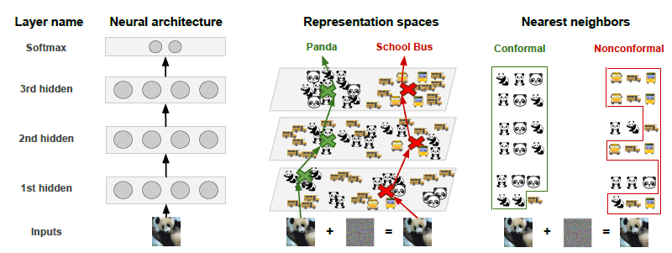
“Deep k-Nearest Neighbors” (DkNN)
Paper: Deep k-Nearest Neighbors: towards confident, interpretable and robust deep learning by Papernot and McDaniel (2018)
Addresses:
Confidence: Distance test input and model’s training points
Interpretability: Find points on training manifold near prediction
Robustness: Prediction’s support is consistent across net-layers

Slide 6
Further research suggestions
Idea 1: Is there a correlation between confirmability and accuracy?
Idea 2: Apply DkNN to training data to learn which data points can be distinguished and which not (in light of confirmability over the layers; to get some explainability intuition)
Idea 3: Compare (aggregated?) heatmaps of nearest neighbors
Idea 4: Consider non-confirmability over the layers (indicator of overfitting and advice regarding net-architecture)

